Slide 1


Supplier Quality Analysis

Slide 2

Content
01
Executive Summary
02
Introduction & Goals
03
Data source & ETL
04
EDA & Insights
05
Dashboard & Charts
06
Future Work & Recommendations

Slide 3

Introduction

Slide 4

Introduction
In this project, we aimed to streamline and enhance our decision-making process by analyzing vendor performance through a comprehensive data analysis approach. We collected and processed large datasets related to vendor transactions, including key metrics such as defected quantities , downtime hours, and martial type. By employing a structured ETL (Extract, Transform, Load) process, we ensured that the data was accurate, clean, and ready for analysis by using Excel’s Power query, and SQL.
Using Tableau, we created an interactive dashboard that provides top management with insights into vendor performance, allowing for quick benchmarking and data-driven decisions. This will help improve vendor selection, optimize supply chain efficiency, and ultimately lead to cost reductions and improved service levels.

Slide 5

Executive Summary
&
Key Findings

Slide 6

Executive Summary
This project provides a comprehensive analysis of vendor performance, delivering key insights that will guide better decision-making. Our analysis revealed several crucial findings: the logistics category experienced the highest downtime, while packaging showed the highest number of defected quantities. Vendor Hotity emerged as the worst-performing vendor in terms of defected quantity, raising concerns about product quality. Additionally, we identified that the Appleton plant, located in Wisconsin, had the highest average defected quantity across all regions.
These insights allow us to better understand the specific areas where performance is lagging and highlight opportunities for improvement. By using our interactive Tableau dashboard, top management can easily benchmark vendors, negotiate better terms with high-performing vendors, and address potential risks posed by underperformers. This will lead to improved operational efficiency, reduced costs, and enhanced product quality, ultimately benefiting our market position and customer satisfaction.

Slide 7

Goals
Improve Supplier Performance: Analyze defect rates to identify underperforming suppliers and implement corrective actions to improve quality.
Enhance Product Quality: Assess the impact of supplier defects on final product quality and reduce the occurrence of defective items.
Reduce Downtime: Minimize production delays by addressing root causes of defects from suppliers and optimizing supply chain efficiency.
Strengthen Supplier Relationships: Foster collaborative relationships by providing suppliers with performance feedback and aligning on quality improvement initiatives.
The main goal of this project is to leverage supplier quality data to boost overall operational efficiency, ensure product consistency, reduce costs related to defective products, and enhance supply chain resilience by the vendor benchmarking insights.

Slide 8

Data source
&
ETL Process

Slide 9

Data Source
In our data analysis project, we sourced our data from the DEPI instructor Eng. Yasser A. Rahman, which provided raw datasets containing essential information such as :
Vendor: Lists vendors with corresponding IDs.
Plant: Provides information on plants, including plant names, regions, and IDs.
Material Type: Contains a list of material types with their respective IDs.
Defects: Describes various defects along with their IDs.
Defected Items: Tracks defect incidents, including dates, plant IDs, vendor IDs, material IDs, defect types, quantities, and downtime.
Defect Types: Categorizes defects as either "Impact," "No Impact," or "Rejected" along with their type IDs.
Category: Provides subcategories (e.g., Electrical, Logistics, etc.) along with their IDs.
The data was often incomplete or inconsistent, necessitating a structured ETL (Extract, Transform, Load) process to ensure its quality and integrity. During the extraction phase, we pulled data from various sources, followed by the transformation phase, where we cleaned and enriched the data to make it suitable for analysis. This involved handling missing values, standardizing formats, and applying business logic to derive new metrics. Finally, we loaded the processed data into Tableau, ensuring it was ready for visualization and insight generation. This robust ETL process allowed us to build accurate, reliable dashboards and reports for informed decision-making.

Slide 10

EDA
&
Most Important Insights

Slide 11
EDA & Insights
In the EDA phase of our project, we conducted a thorough examination of the dataset to understand its structure, detect anomalies, and identify patterns or trends. We began by checking for missing values, inconsistencies, and outliers, followed by visualizing key variables to gain initial insights. Correlations between different fields were explored, and categorical data was analyzed to determine the distribution of vendors and product categories. This process helped us uncover significant relationships between variables and provided a foundation for deeper analysis and decision-making.
Most Important Insights:
Logistics Downtime: The logistics category had the highest downtime, indicating potential inefficiencies in supply chain management.
Packaging Defects: Packaging showed the highest number of defected products, pointing to quality control issues in this area.
Vendor Hotity Performance: Vendor Hotity had the worst performance in terms of defected quantities, raising concerns about its reliability and product quality.
Regional Disparities: The Appleton plant, located in Wisconsin, reported the highest average defected quantity, suggesting localized issues that may require targeted intervention.
Correlation Between Defects and Downtime: A weak correlation was found between downtime and defected quantities.

Slide 12
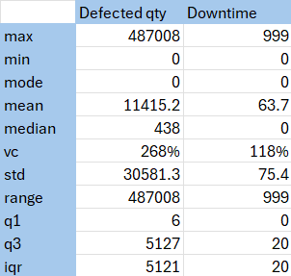
EDA & Insights
we found out that the data is not centralized the variance among them is pretty high so is it what it is supposed to be ?
well yes after searching and looking around for supplier quality analysis high variance and non centralized data in this field is kinda normal
we also find out that most of our data is around raw materials ( 76% from our data ) no need to worry about high numbers coming from this category.

Slide 13
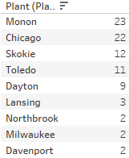
EDA & Insights
For zero mode in business Implications A high number of zero defects could be interpreted positively (high-quality production), but we should also ensure that reporting mechanisms are accurate, and no defects are being underreported, The zeros in our data takes 28.5% from the data lets make further investigations
This data represents the counts of zero defects at each plant, Chicago (22 zeros) and Monon (23 zeros) have the highest number of zero-defect entries. This means these two plants often deliver defect-free batches, which is a positive indicator of quality from those plants.

Slide 14
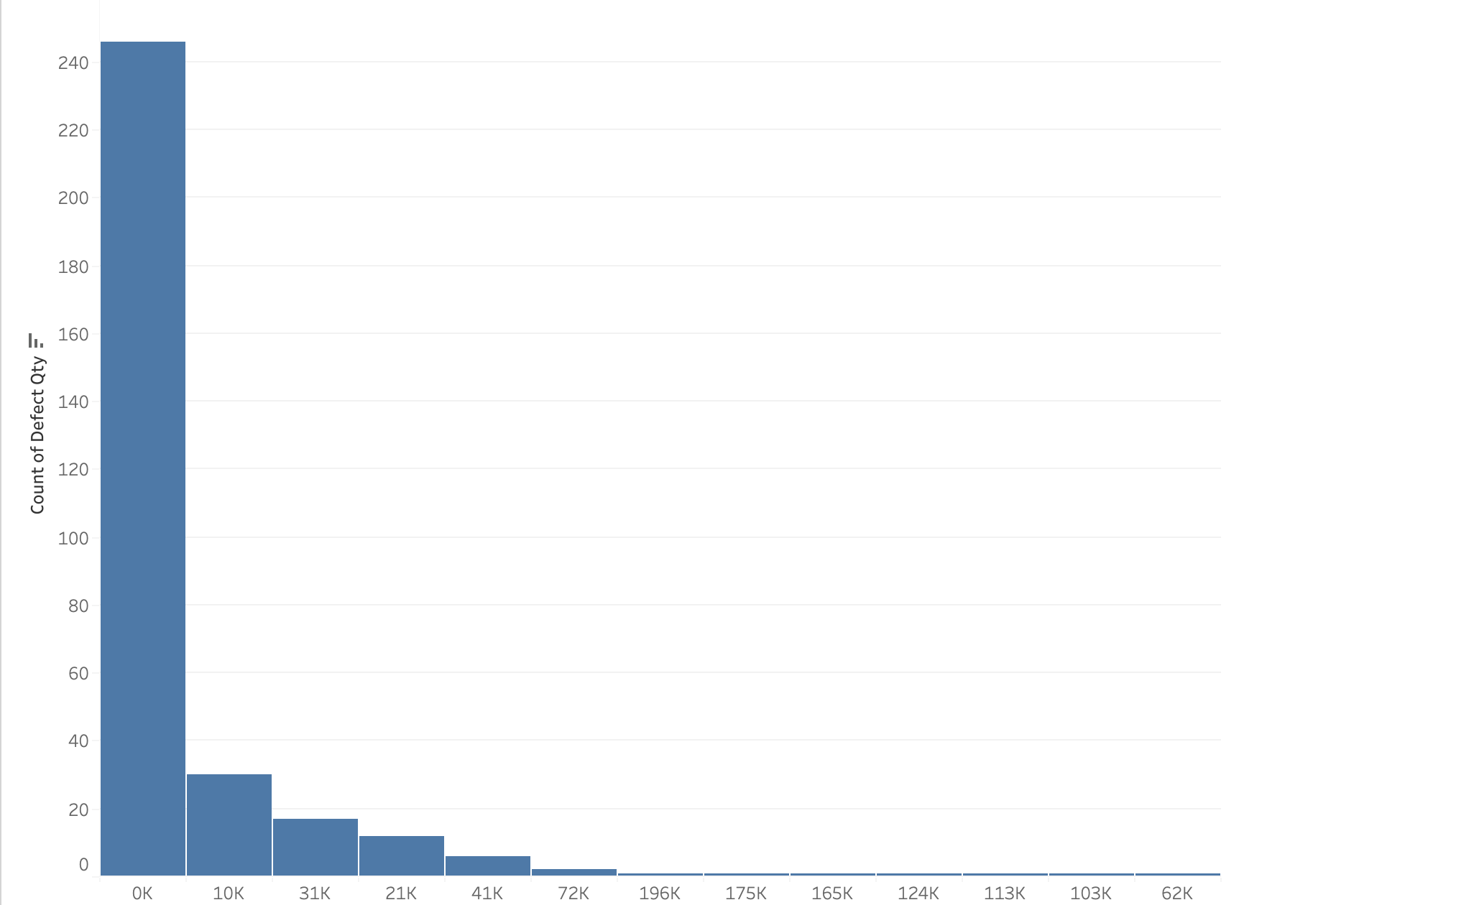
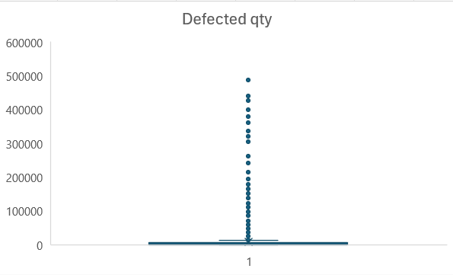
Descriptive statistics & Visualizations(Defected Qty)
Histogram
Box-Plot

Slide 15
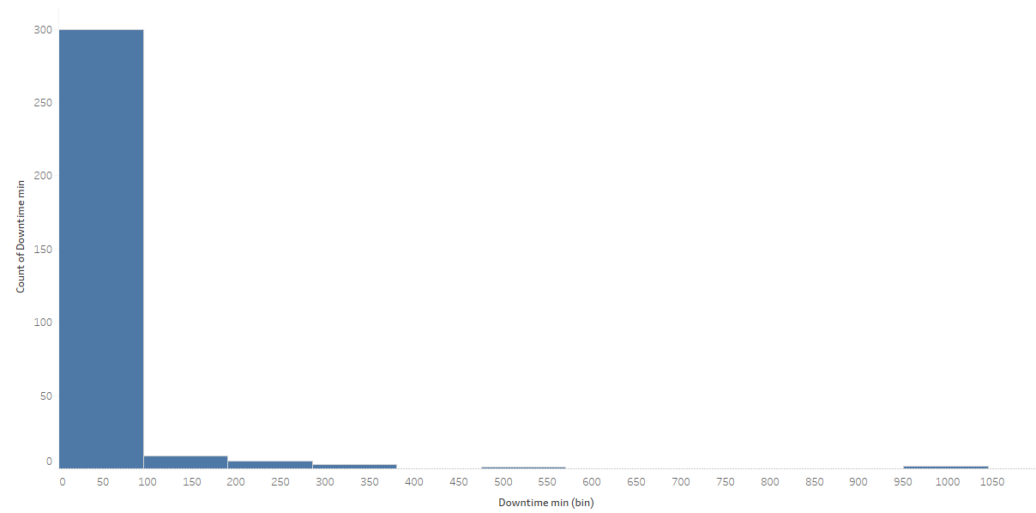
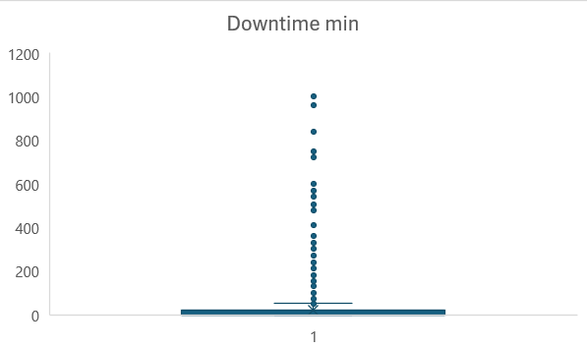
Descriptive statistics & Visualizations(Downtime min)
Histogram
Box-Plot

Slide 16

Data Cleaning

Slide 17
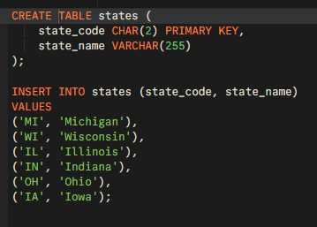
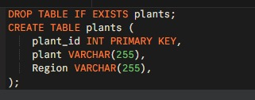
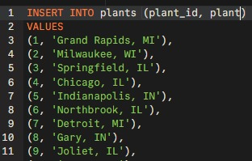



Data Cleaning by SQL
Split plant column by delimiter ( , )
Trimmed column from space replaced state code with state name

Slide 18
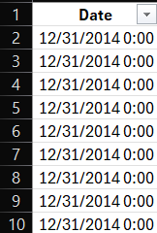
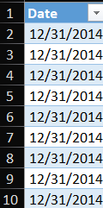
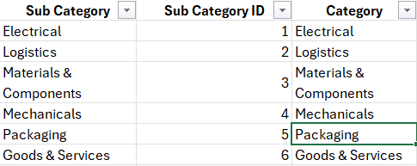

Data Cleaning in Power Query
1st step removed clock from date removed unnecessary columns(category)
2nd step created a calendar using M language

Slide 19

Dashboard
&
Visualizations

Slide 20
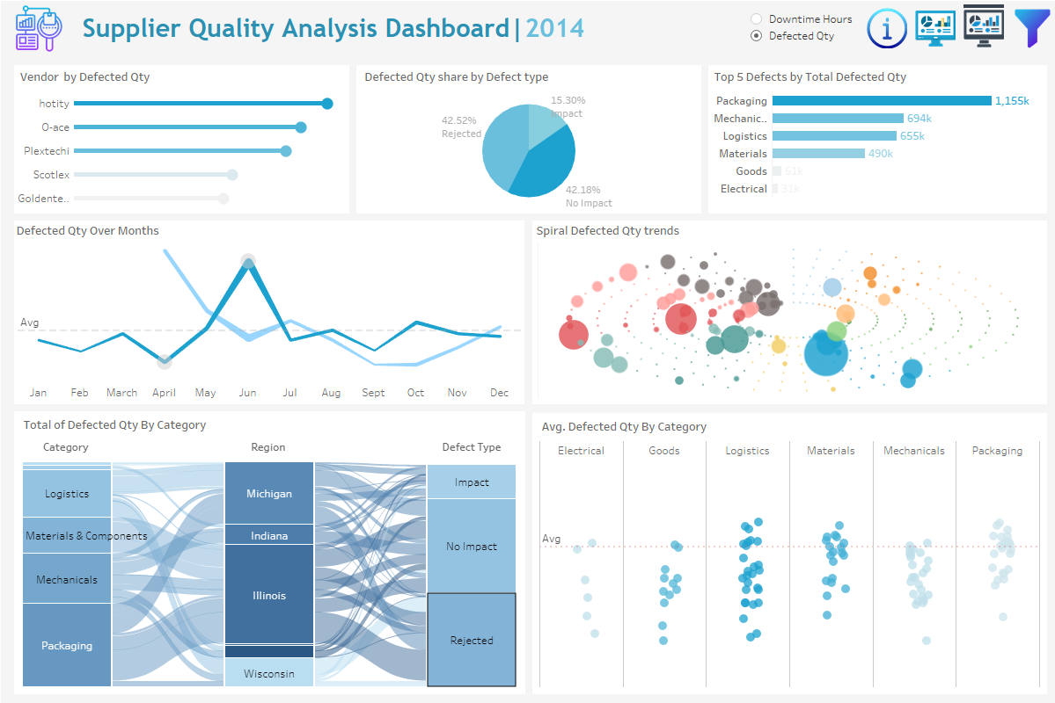

Slide 21
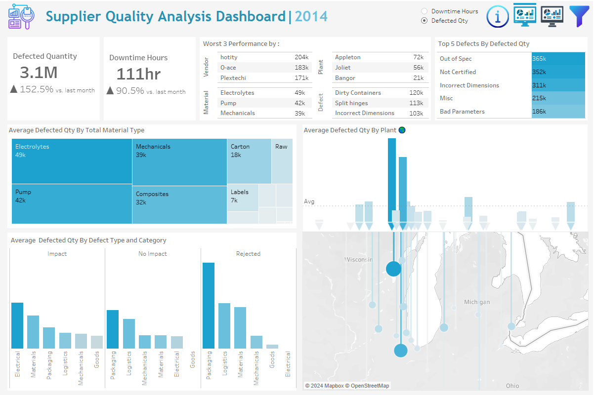

Slide 22
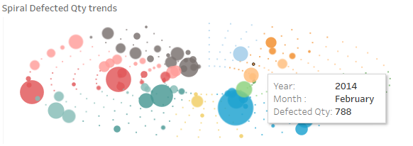
Spiral Defected Qty trends

Slide 24

Future Work
& Recommendations

Slide 25

Future Work
Based on the current Supplier Quality Analysis Dashboard, future work should aim to refine and expand the existing analysis to gain deeper insights into defect trends and performance improvement opportunities. One area for enhancement is to integrate predictive analytics to forecast potential defect patterns, allowing for proactive quality control measures.
Additionally, incorporating real-time monitoring of defects and downtime could enable immediate responses to emerging issues, reducing the overall defected quantity and downtime hours. Further segmentation of data by vendor performance and plant location could be explored to identify specific root causes of defects and downtime.
It would also be beneficial to develop more detailed drill-down capabilities for each defect type and region, providing a clearer picture of underlying problems. Lastly, recommendations include adding interactive filters to allow stakeholders to focus on specific materials, regions, or vendors, which would improve decision-making and facilitate targeted quality improvement initiatives.

Slide 26

Recommendations
Focus on High-Impact Defects: The dashboard shows significant downtime due to issues such as "Film Not Intact" and "Incorrect Dimensions." Prioritize addressing these defects by conducting root cause analysis and implementing targeted process improvements. Reducing these high-impact defects could lead to substantial gains in efficiency and cost savings.
Improve Vendor Performance: Vendors such as Hotity and O-ace are underperforming. It is recommended to establish stricter quality control measures and performance-based contracts with these suppliers. Consider vendor audits and offering support to improve their processes, ensuring that they meet the company's quality standards.
Regional Optimization: The "Total Material Type by Region" visualization highlights some regions that experience higher defect volumes. Conduct in-depth reviews of the processes in these regions to identify inefficiencies and implement region-specific solutions. Aligning manufacturing practices across all regions will help maintain consistent quality levels.
Enhance Training Programs: Some recurring defects, such as "Incorrect Dimensions" and "Split Hinges," suggest possible process or human errors. Introducing additional training for employees at various plants, especially those with the most reported defects, can reduce errors and improve product quality.
Leverage Data for Preventive Maintenance: Utilize the data insights from defects and downtime to create a preventive maintenance schedule. Addressing potential failures before they lead to defects will improve production uptime and reduce costly downtime.

Slide 27
Recommendations

Slide 28


Kariman Samir
Rama Ehab
Mohamed Rabea
Kareem Younis

Slide 29

Thank You

